Slide 1
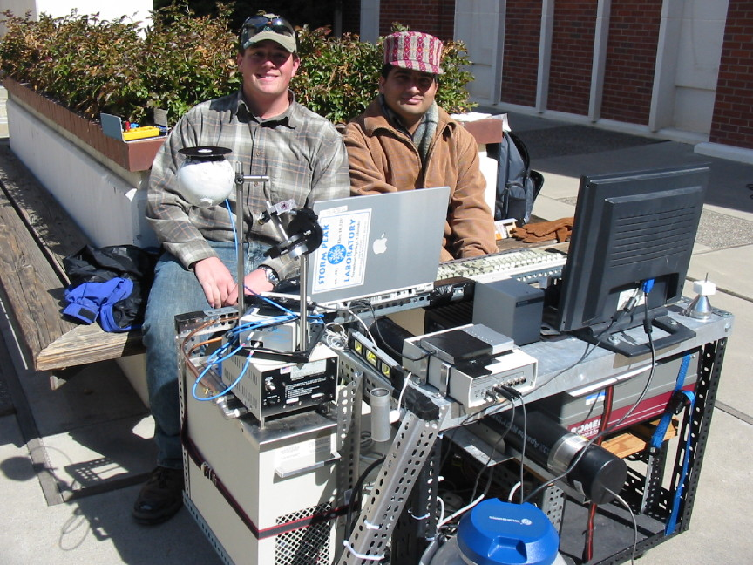
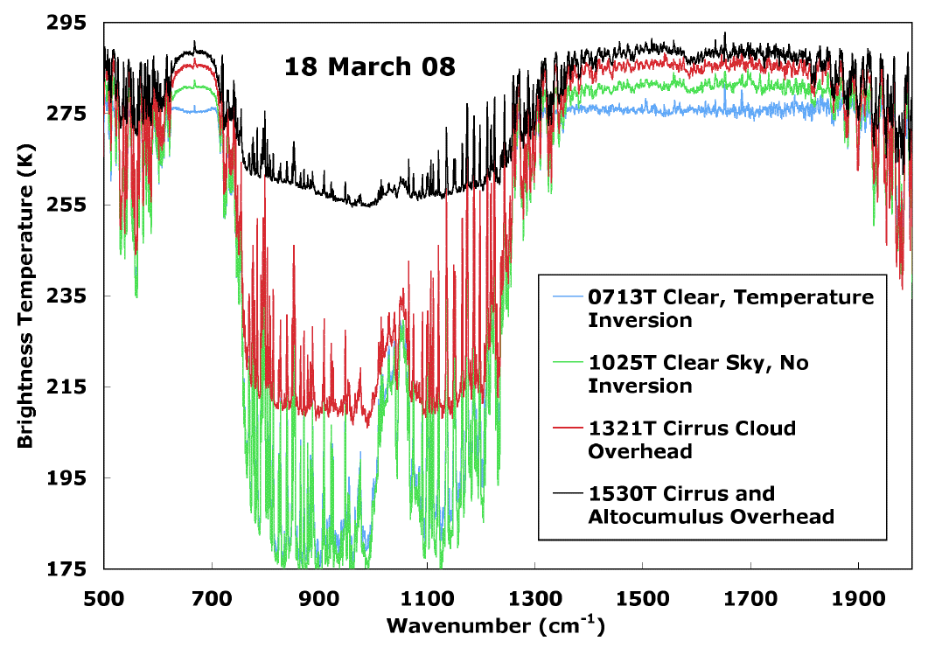
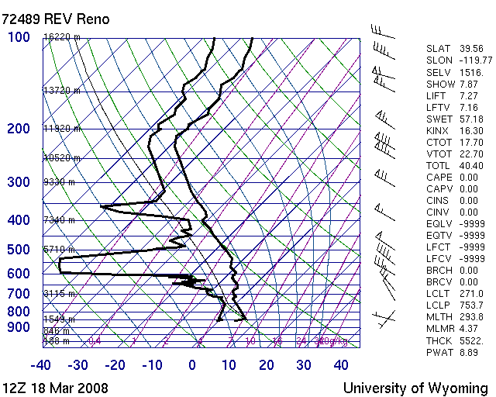
Downwelling IR Example for Clear and Cloudy Sky Conditions. Measurements during ATMS360 Instrumentation Course.

